Slide 1
Crime in Chicago: An analysis of crime in the City of Chicago from 2001-Present
Created by ,
Constance Vance
Neel Patel
Neel Savla

Slide 2
Introduction
Our project is about Chicago crimes from 2001 to present date. We have taken dataset from open source website https://data.cityofchicago.org .
Our dataset contains 22 columns like crime id, case number, primary type, description, location, arrest, FBI code, community area, year etc.
And about 4 million rows of data.
We are analyzing this data, as this data set contains information from last 16 years and it is been updated everyday until today.

Slide 3
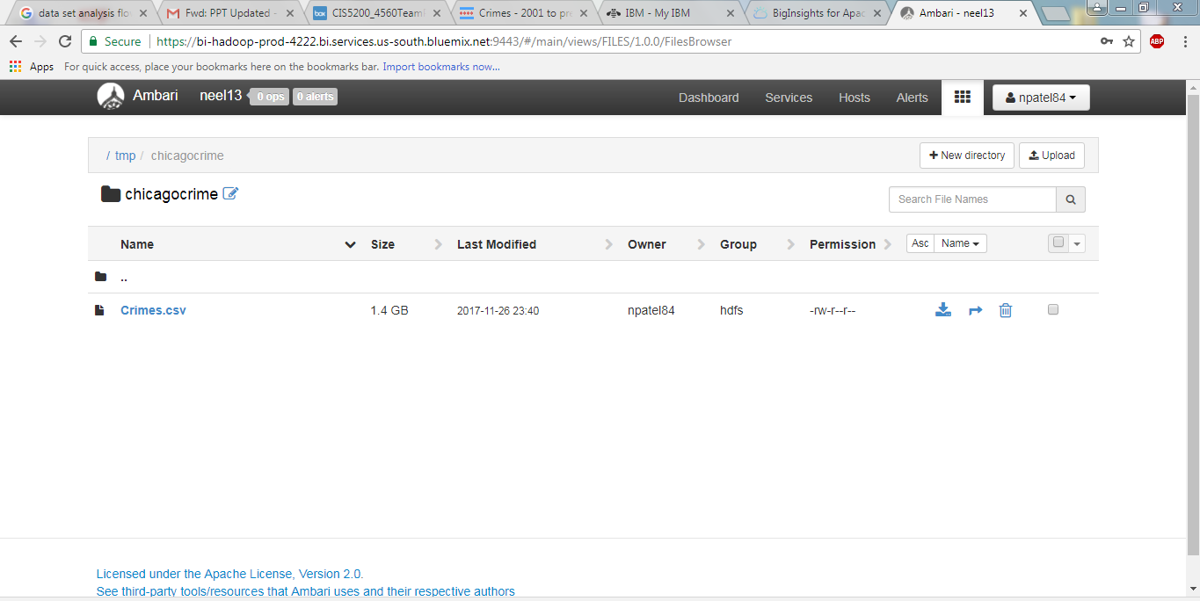
The size of our dataset is 1.4 GB.

Slide 4
Technical Specification
DATA DISK: 1TB SATA
Number of CPUs: 4 VCPU
Memory Size: 24 GB RAM
Number of Nodes: 1 DATA NODE
Version: IOP 4.2

Slide 5
Flowchart
Download data from https://data.cityofchicago.org
Uploaded the text files into HDFS using Ambari
Created tables using Hive
Analysis of graphs using Tableau 10.4

Slide 6
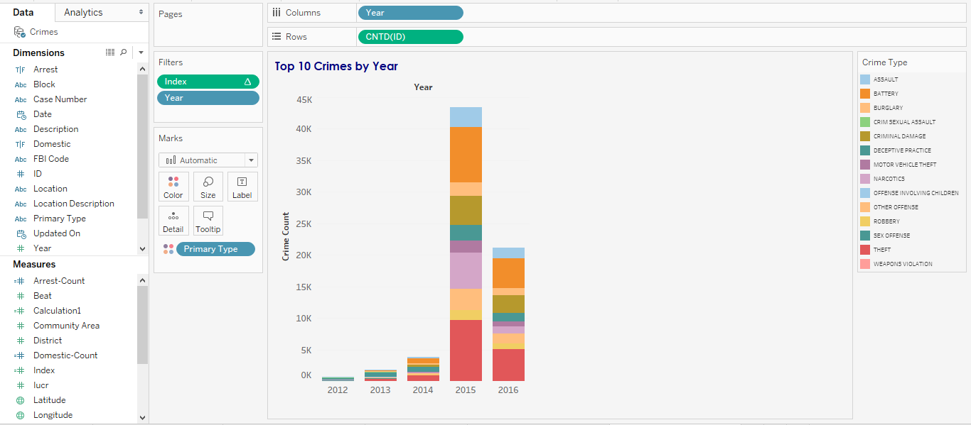
Top Crimes Each Year from 2012-2016

